Slide 1

GROUP -10
POWERPOINT PRESENTATION
BY

Slide 2

American International University Bangladesh-AIUB
Faculty of Engineering
Final Term Presentation-Fall 2021-22
Course: Computer Aided Design & Drafting.
Faculty: DR. MD. MAHADI HASAN
Topic: Duplex House Design and Electrical Connection Using AutoCAD.
Name | ID
Md. Abdul Muneem Adnan | 20-44213-3
Joydep Dhar | 20-44237-3

Slide 3
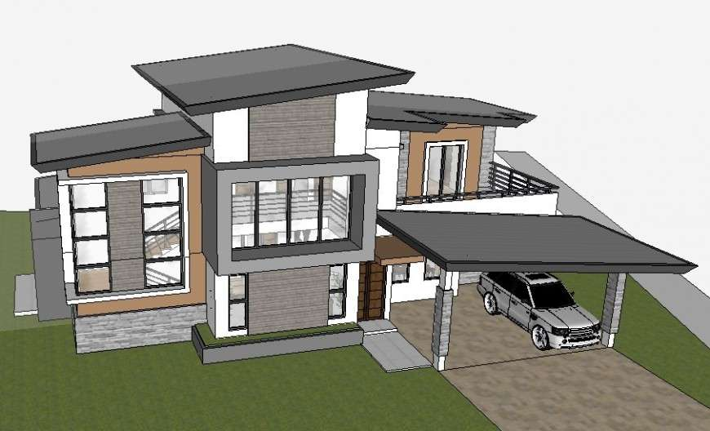
Table of Contents:
Introduction to The Civil Drawing;
Placement of The Electrical Fittings;
Wiring and Power Distribution;
Calculation of Load

Slide 4
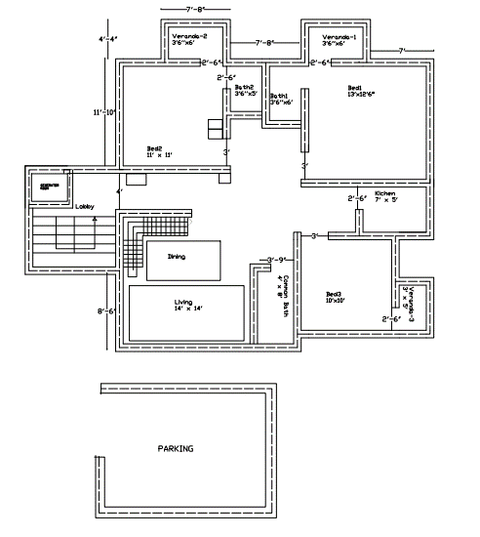
Introduction to the Civil Drawing:
Software: AutoCAD 2007.
3-Bed-Room;
3-Toilet;
3-Varenda;
Kitchen;
Drawing-room;
Dinning;
Lobby;
1-Generator room;
1-Parking-area;

Slide 5
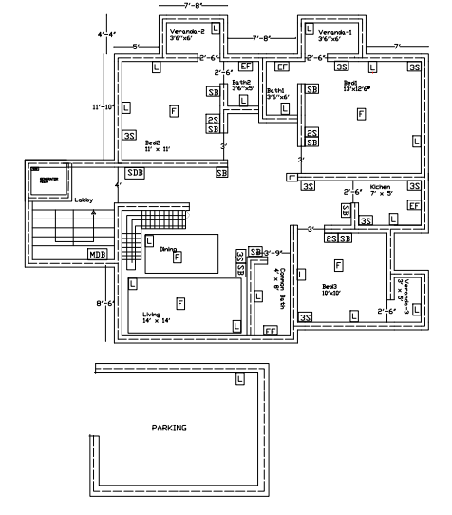
Placement of the Electrical Fittings:
Switch Board [SB];
Sufficient Number of Light[L] & Fan[F];
Socket (2 pin[2S]=5A,3pin[3S] =15A);
BNBC Rules– 1993,
Sub Distribution Board-SDB;
Main Distribution Board-MDB;

Slide 6
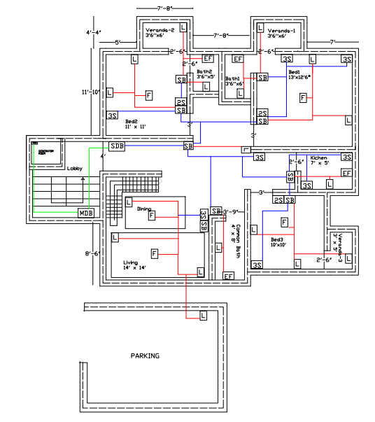
Wiring and Power Distribution:
First Layer: Low Voltage equipment (SB),
Second Layer: High Voltage equipment
Third Layer: Internal connection (SB)to(SDB),
Fourth Layer: TJB and Dish connection line,
Fifth Layer: MDB to each SDB all the connection.
PVC riser (Carrier of main power cables)

Slide 7
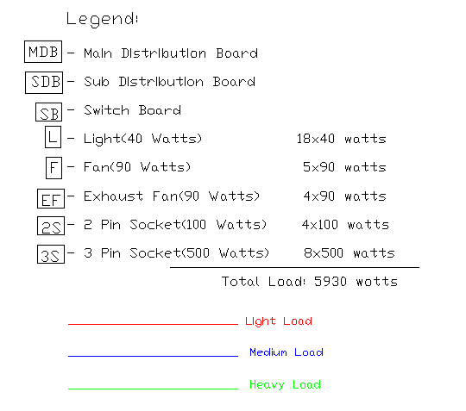
Calculation of Load:

Slide 8


